Slide 1
X11 Decomposition

Slide 2
Description of the algorithm
STEP A
Adjustment for REGARIMA, forecasts, backcasts
SA decomposition
STEP B
Initial decomposition in T, S, I
E
Series corrected for atypical points
STEP C, D
Final decomposition
F
Diagnostics

Slide 3
















Step B (Initial decomposition, monthly series)
B2
$${T_{0}=f(Y}_{A})$$
2 x 12 filter
B8
$${{SI}_{B}=Y}_{A}−T_{B}$$
B3
$${{SI}_{0}=Y}_{A}−T_{0}$$
…
$$S_{2}=f({SI}_{B})$$
s3x5 filter
…
$$S_{0}=f({SI}_{0})$$
s3x3 filter
…
$$I_{2}={SI}_{B}−S_{2}$$
…
$$I_{0}={SI}_{0}−S_{0}$$
B9, B9g
$$X_{B}=X\left({SI}_{B}\right), { \tilde{SI}}_{B}$$
Xtremes
B4, B4g
$$X_{0}=X\left({SI}_{0}\right), { \tilde{SI}}_{0}$$
Xtremes
B10
$$S_{B}=f({\tilde{SI}}_{B})$$
s3x5 filter
B5
$$S_{1}=f({\tilde{SI}}_{0})$$
s3x3 filter
B11
$${{SA}_{B}=Y}_{A}−S_{B}$$
B6
$${{SA}_{1}=Y}_{A}−S_{1}$$
B13
$${I_{B}=SA}_{B}−T_{B}$$
B7
$${T_{B}=f(SA}_{1})$$
Henderson filter
B20
$$X_{fac B}=X_{fac}\left(I_{B}\right)$$
Xfactors

Slide 4
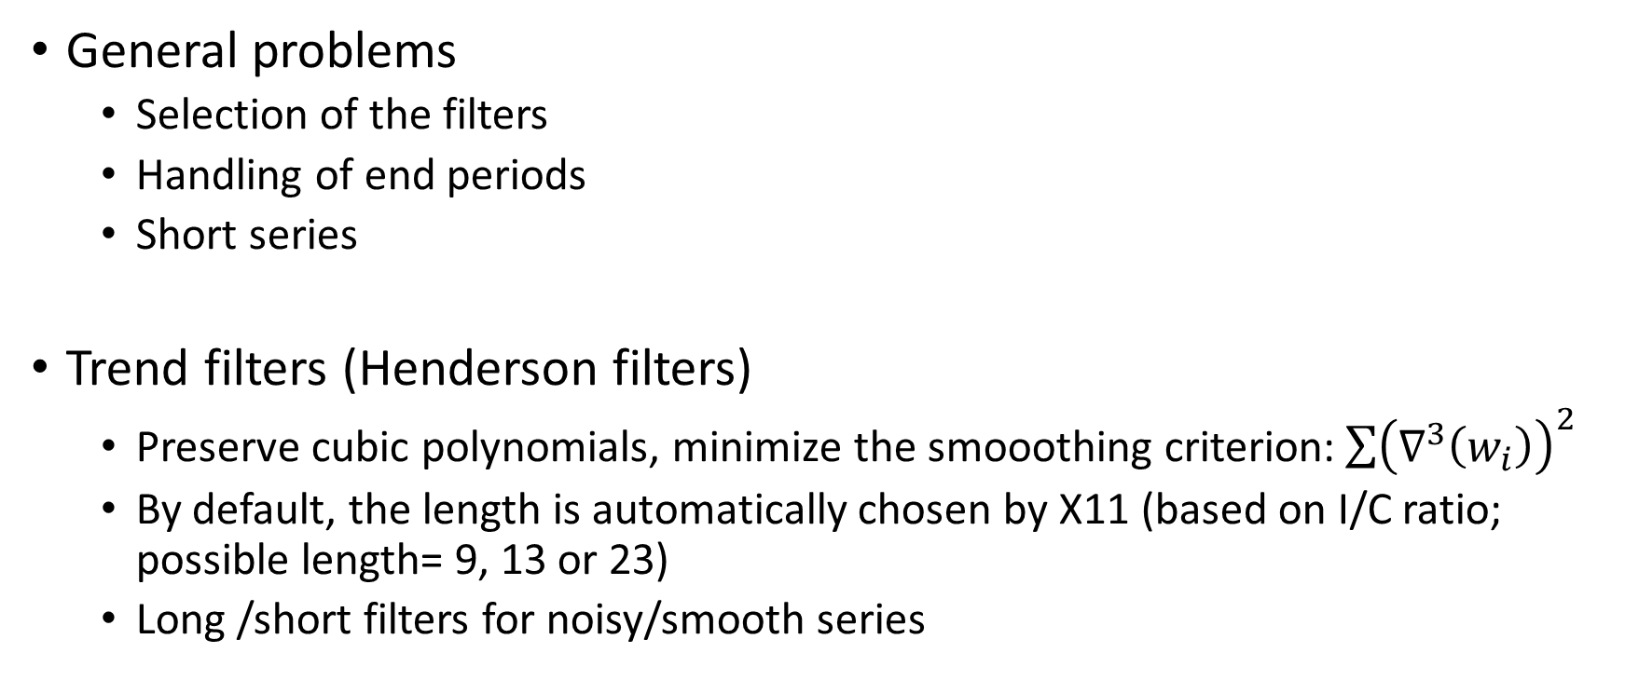
X11 Filters
General problems
Selection of the filters
Handling of end periods
Short series
Trend filters (Henderson filters)
Preserve cubic polynomials, minimize the smooothing criterion:$\sum{{\left(∇^{3}\left(w_{i}\right)\right)}^{2}}$
By default, the length is automatically chosen by X11 (based on I/C ratio; possible length= 9, 13 or 23)
Long /short filters for noisy/smooth series

Slide 5
X11 Filters (cont.)
Asymmetric Musgrave filters for end-points
Correspond to the criterion of minimum mean square revision error, under the hypothesis that the series follows a linear trend at the ends of the period (→huge revisions at turning points)
Seasonal filters
S3x1, S3x5… S3x15 applied on each month/quarter.
Different filters for different periods
By default, the length is automatically chosen by X11 (based on moving seasonality ratio; S3x3, S3x5 or S3x9)
Ad hoc asymmetric filters for end-points

Slide 6
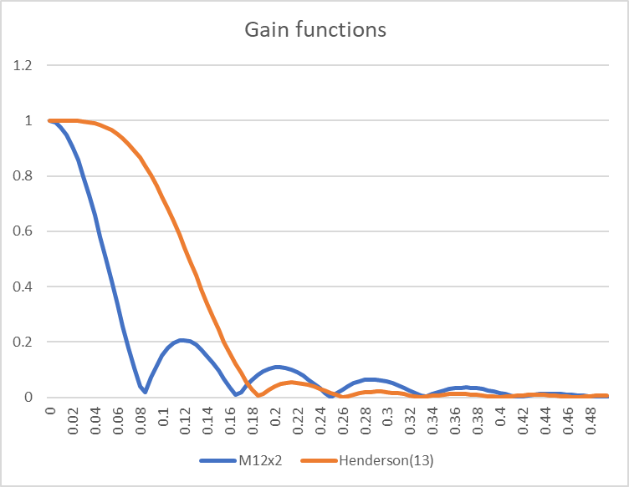

X11 filters
Trend filters
M12x2: $\left[\begin{matrix}\frac{1}{24} & \frac{1}{12} & ⋯ & \frac{1}{12} & \frac{1}{24}\end{matrix}\right]$
Henderson(9,13 or 23):

Slide 7
Henderson filters
H13 weights:
-0.01935 | -0.02786 | 0 | 0.065492 | 0.147357 | 0.214337 | 0.240057 | 0.214337 | 0.147357 | 0.065492 | 0 | -0.02786 | -0.01935

Slide 8
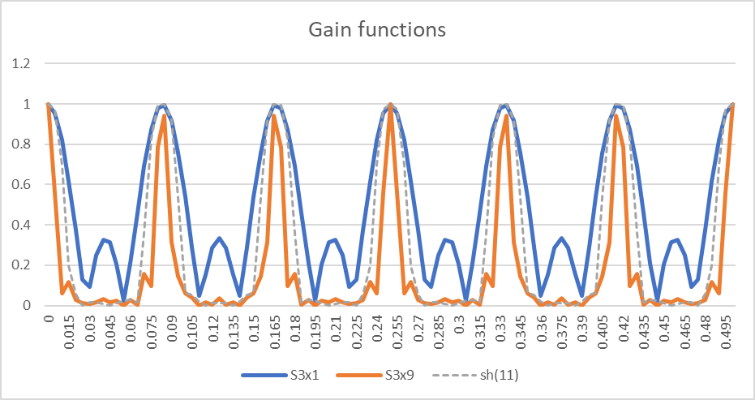
X11 filters
Seasonal filters
S3x1
S3x3
S3x5
S3x9
s3x15

Slide 9









Step C (monthly series)
C1
$${Y_{C}=Y}_{A}−X_{fac B}$$
C9
$${{SI}_{C}=Y}_{C}−T_{C}$$
C2
$${T_{0}=f(Y}_{C})$$
2 x 12 filter
C4
$${{SI}_{0}=Y}_{C}−T_{0}$$
C10
$$S_{C}=f({SI}_{C})$$
s3x5 filter
C5
$$S_{1}=f({\tilde{SI}}_{0})$$
s3x3 filter
C11
$${{SA}_{C}=Y}_{C}−S_{C}$$
C6
$${{SA}_{1}=Y}_{C}−S_{1}$$
C13
$${I_{C}=SA}_{C}−T_{C}$$
C7
$${T_{C}=f(SA}_{1})$$
Henderson filter
C20
$$X_{fac B}=X_{fac}\left(I_{B}\right)$$
Xfactors

Slide 10










Step D (final step, monthly series)
D1
$${Y_{D}=Y}_{A}−X_{fac C}$$
D8
$${SI}_{D}=Y_{A}−T_{1}$$
D2
$${T_{0}=f(Y}_{D})$$
2 x 12 filter
D4
$${{SI}_{0}=Y}_{D}−T_{0}$$
D10
$$S_{D}=f(Y_{D}−T_{1})$$
s3x5 filter
D11
$${SA}_{D}=Y_{A}−S_{D}$$
D12
$$T_{D}=f(Y_{D}−S_{D})$$
Henderson filter
D5
$$S_{1}=f({\tilde{SI}}_{0})$$
s3x3 filter
D13
$$I_{D}={SA}_{D}−T_{D}$$
D6
$${{SA}_{1}=Y}_{D}−S_{1}$$
D7
$${T_{1}=f(SA}_{1})$$
Henderson filter

Slide 11
X11 Diagnostics: M-Statistics (from C. Hood consulting)
M1 and M2 are designed to measure the relative strength of the variation in the irregular component versus the variation of the seasonal component. The idea is that if there is too much irregular, then the program won’t be able to separate the irregular and seasonal well. M1 and M2 test this property by using two different functions to detrend the series.
M1 is the relative contribution of the irregular over three months span. You can improve the M1 diagnostic, sometimes, with changes to the seasonal filters or to the sigma limits. Shortening the series can also improve this diagnostic.
M2 is the relative contribution of the irregular component to the "stationary portion of the variance." M2 values can be misleading if the trend shows several changes of direction or in some other way is not well-approximated by a straight line. For this reason, X-12/X-13 computes Q2, a weighted average of the M statistics that excludes M2. Generally you can ignore failing M2 statistics.

Slide 12
M-statistics (cont’)
M3 and M5 are designed to see if there is too much irregular in the series relative to the trend. Again, the idea is that if there is too much irregular in the series, the program will not be able to separate the trend from the irregular. M3 is the amount of month-to-month change in the irregular component as compared to the amount of month-to-month change in the trend-cycle. M5 is the number of months it takes the change in the trend-cycle to surpass the amount of change in the irregular, using a statistic called "months to cyclical dominance."
Both M3 and M5 may fail if we have a series with a very flat trend because the change in the irregular will always be more than the change in the trend. For a series like this, there is nothing we can do to improve the diagnostics, but nothing needs to be done. If the series has a flat trend, X-12/X-13 can estimate it quite easily, and there is no cause for concern if M3 and/or M5 fail.

Slide 13
M-statistics (cont’)
M4 tests for randomness in the irregular component using a statistic called the average duration of run.
Because the irregular is not really white noise anyway, this statistic is not very important in the overall picture. It is the M statistics with the smallest weight in the Q and Q2 statistics.
M6 checks if a 3x5 seasonal filter is the correct seasonal filter based on the moving seasonality ratio. If the seasonal filter used in the run is not a 3x5, the program will not use M6 to compute the overall Q statistic.
If this diagnostic fails, and you are using a 3x5 filter, then you should change the seasonal filter length. If you are NOT using a 3x5 filter, or if X-12/X-13 doesn't choose a 3x5 filter for the last seasonal estimation, then you can ignore the M6 diagnostic.

Slide 14
M-statistics (cont’)
M7 is the most important M statistic, and forms what X-11-ARIMA calls the "test for identifiable seasonality." It tests the amount of moving seasonality present relative to the amount of stable seasonality. Because of the moving average procedures in X-11/X-12/X-13, too much moving seasonality may cause problems in the estimation of the series components.
If this diagnostic fails, then there is probably nothing that can be done to correct it. The series probably is not seasonal and should not be seasonally adjusted. There are cases when we have a short series and a very bad model, and fixing the model may fix the M7 diagnostic. Also, there are times when we have a very long series, and shortening the series can fix the M7 if the problems.

Slide 15
M-statistics (cont’)
M8, M9, M10, and M11 attempt to find several problems in the seasonal component. M8 uses a measure of the fluctuations in the seasonal component to see if there are too many random fluctuations in the seasonal component, which can be a sign of problems in estimating the seasonal component. M9 examines the linear movement in the seasonal component, and tries to see if the seasonal component is changing too quickly. Again, a high value can indicate problems in estimating the seasonal factors. M10 and M11 are the same statistics as M8 and m9, but they are calculated for only the last few years of the series. M10 and M11 give us insight into the quality of the most recent estimates of the seasonal factors.
High values for M8 and M9 may be fixed with changes to the seasonal filters or to the sigma limits, or by shortening the series. Large residual calendar effects combined with short seasonal filters could also be an explanation.
High values of M10 and M11 are difficult to fix.

Slide 16
To go further
Ladiray and Quenneville (1999). « Comprendre la méthode X11 »
JD+ code (on Github)
ec.satoolkit.x11.X11Kernel
ec.satoolkit.x11.MStatistics

